Slide 1

Taste Buds
Group:0502-06
Member:
Yupeng cui
Yuhan Cui
Huimin Han
Haozhen Bi
Date:2018/12/06

Slide 2

Users and Data Source
Users: Customers using Yelp to check reviews, stars, other users’ information.
Data Source: Data from Yelp dataset including Business(Restaurant), reviews, tips, coupons, open hours, user information.

Slide 3
Mission Statements
Build up the database by using scientific statistical method combining with the reviews by the formal customer, to efficiently providing latest information of restaurants around the university as well as ranking and sorting the result based on their specific preference on the flavor and service to help the customers choose wisely among various catering business.

Slide 4
Mission Objectives
The system shall list available restaurants around University of Phenix.
The system shall precisely filter the result of restaurants based on various requests, e.g. open hours, stars, price, etc.
The system shall provide reviews and tips from previous customers to give suggestions to new customers.
The system shall allow customers to add, alter and delete reviews and tips.

Slide 5
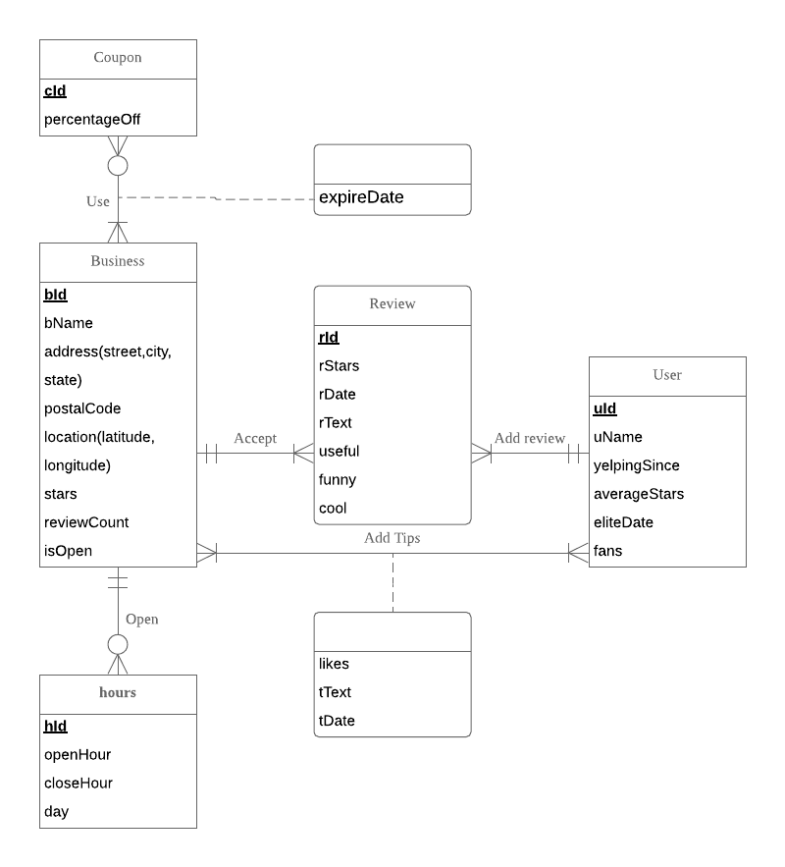
ER diagram

Slide 6
Relational schema
Coupon (cId, percentageOff)
Use (cId, bId, expireDate)
Business (bId, bName, address, city, state, postCode, latitude, longitude, stars, reviewCount, isOpen)
Review (rId, bId, uId, rStars, rDate, rText, useful, funny, cool)
User (uId, uName, yelpingSince, averageStars, eliteDate,fans)
Hours (hId, day, bId, openHour, closeHour)
Addtips (bId, uId, likes, tText, tDate)

Slide 7
Relational schema
Accept: binary relationship
1 Business to 1 or more Reviews
1 Review to 1 Business
Use: binary relationship
1 Coupon to 1 or more Businesses
1 Business to 0 or more Coupons
Open: binary relationship
1 Business to 0 or more Hours
1 Hour to 1 Business
Add Tips (Tip): binary relationship
1 Business to 1 or more User
1 Customer to 1 or more Businesses
Add Review: binary relationship
1 User to 1 or more Reviews
1 Review to 1 User

Slide 8
SQL CREATE TABLE
CREATE TABLE [Yelp.Review] (
rId CHAR(22) NOT NULL,
bId CHAR(22),
uId CHAR(22),
rStars NUMERIC(2,1),
rDate DATE,
rText VARCHAR(255),
useful INTEGER,
funny INTEGER,
cool INTEGER,
CONSTRAINT pk_Review_rId PRIMARY KEY (rId),
CONSTRAINT fk_Review_bId FOREIGN KEY (bId)
REFERENCES [Yelp.Business] (bId)
ON DELETE CASCADE ON UPDATE NO ACTION,
CONSTRAINT fk_Review_uId FOREIGN KEY (uId)
REFERENCES [Yelp.User] (uId)
ON DELETE CASCADE ON UPDATE CASCADE);

Slide 9
Which 5 restaurants have the highest average reviews?
SELECT top 5 B.bName,AVG(rStars) AS 'average stars'
FROM [Yelp.Business] B, [Yelp.Review] R
WHERE R.bId = B.bId
AND 'average stars'>=(SELECT MAX('average stars')
FROM [Yelp.Review])
GROUP BY bName
ORDER BY 'average stars' desc

Slide 10
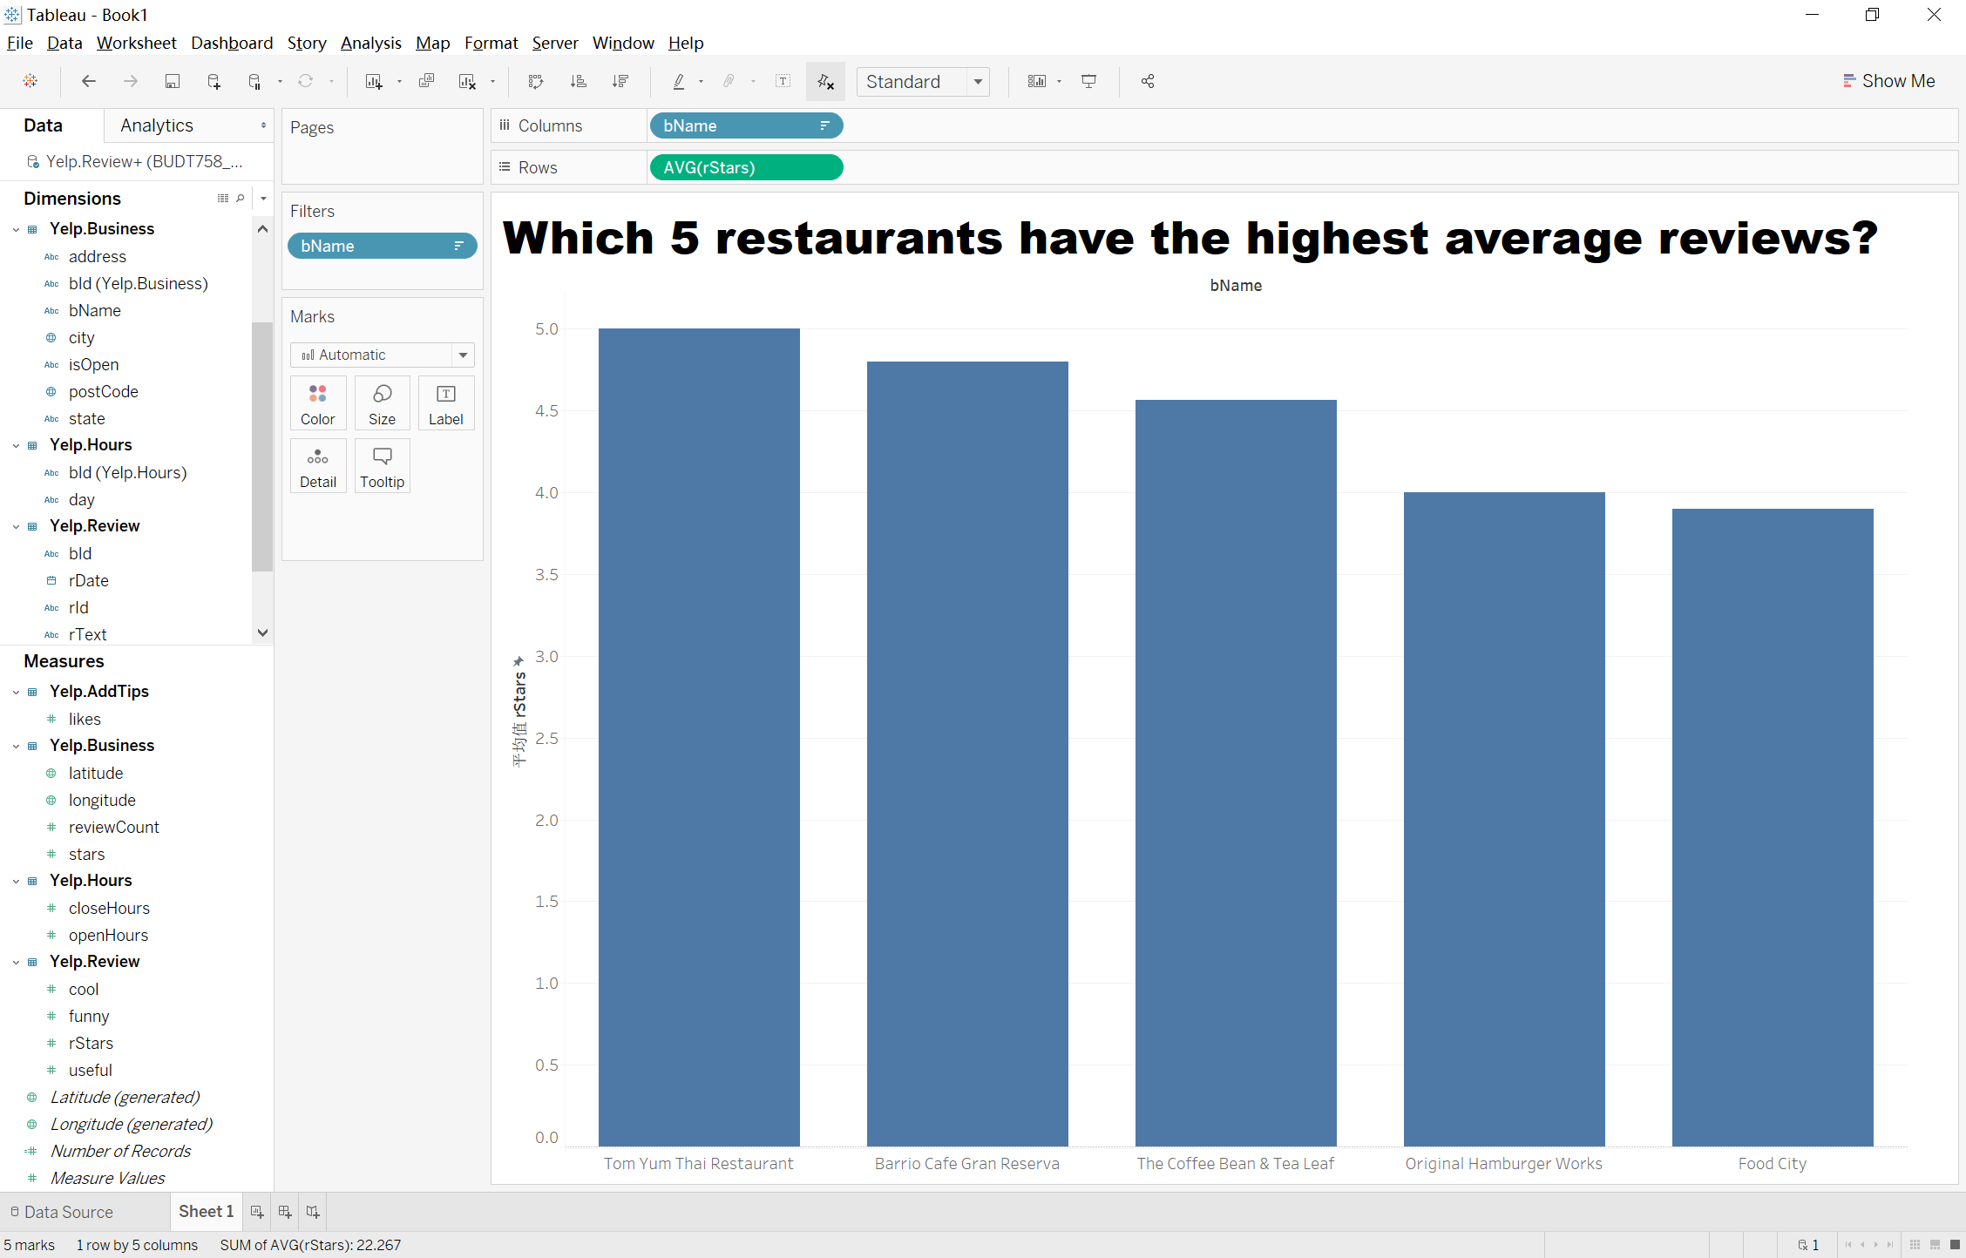

Slide 11
How many five-star reviews do restaurants have ever got?
SELECT b.bName,COUNT(r.rId) AS 'Number of 5 stars'
FROM [Yelp.Review] r,[Yelp.Business] b
WHERE r.bId=b.bId AND rStars=5
GROUP BY bName

Slide 12
